Slide 1
GOOGLE PLAY STORE PROJECT
by Reynold M. Mikado
9th June 2023.

Slide 2
Project Objective
Understand trend of products on Play Store and consequently the android app market.
Uncover business insights as it relates to advertisements and investments.
Source of data : Kaggle

Slide 3
Outline
About
Data Overview
Data Preparation
Statistical Summary
Analysis and Visualization
Business Insights and Recommendations
Future Work
Conclusion

Slide 4
About Google Play Store
Mobile Applications Hub
Stage for Developers
Market for Investors
Media platform for products

Slide 5
Data Overview
10841 observations organized in 13 variables.
Names : specific name of the products on the platform
Category : Group under which an products falls.
Rating : Numeric summary of user’s satisfaction of a product
Reviews : User’s verbal assessment of an product
Size : App Storage space in Kb.
Installs : Number of user installations of a product.
Type : Subscription options provided by the product developer.
Price : Cost of product in dollars
Content Rating : Suitable age group for a product
Genres : Group under which a product falls.
Last Updated : Date of current update installed by the product developer.
Current Version : Latest version of the product
Android Version : Compatible android version for the product

Slide 6
Data Preparation
Dropped Unrelated Columns : Genres, Types, Last Updated, Current Ver, Android Ver
Dropped Insignificant Row.
Datatype Conversion to Numeric : Reviews, Size, Installs, Price.
Missing Value Treatment : Imputed Rating column with column mean

Slide 7
Statistical Summary
9366 unique products & 33 categories.
4.36 median rating & 4.19 average.
Average number of reviews is 444,152, Median is 2094 & Maximum recorded is 78,156,306.
Average size of product is 31.24Kb.
Maximum installations recorded for a product is 1,000,000,000 !
Average price for paywalled products is $1.04.
Six (6) unique content rating categories.

Slide 8
DATA ANALYSIS AND VISUALIZATION

Slide 9
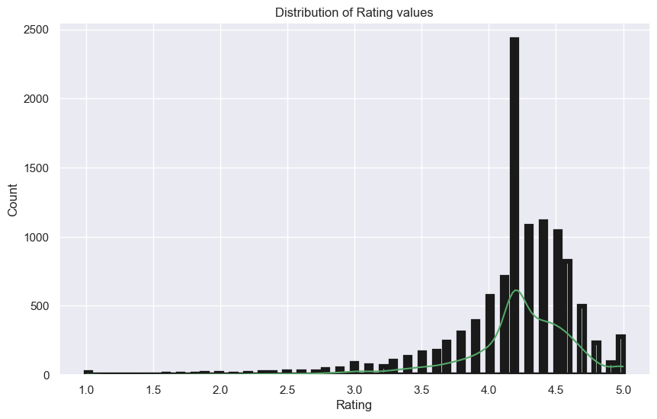
Rating (User’s Quantitative assessment)

Slide 10
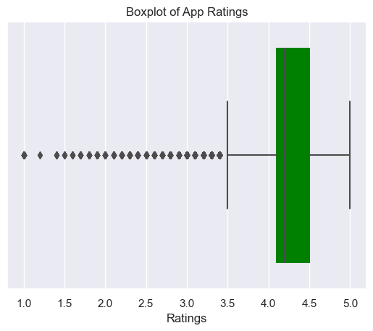
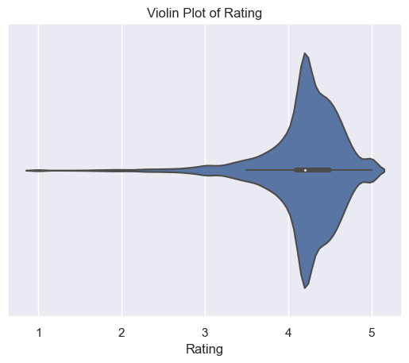
Statistical Distributions of Rating

Slide 11
Observations
Significantly left skewed distribution
Mean rating of 4.19 & Median rating of 4.30
81.6% of ratings within 4.0 – 4.5
2.5% of products have perfect rating; Low installs though.
Notable products : Instagram, Subway Surfers, Google Photos : At least 4.5 Rating, 1B installs & At least 10M reviews.
Eligible for investment or advertisement.

Slide 12
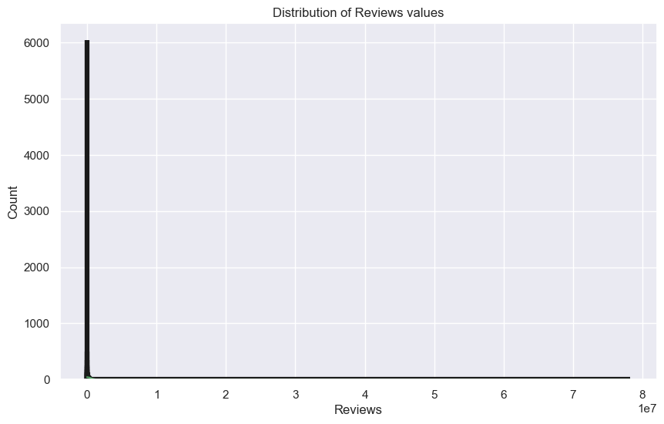
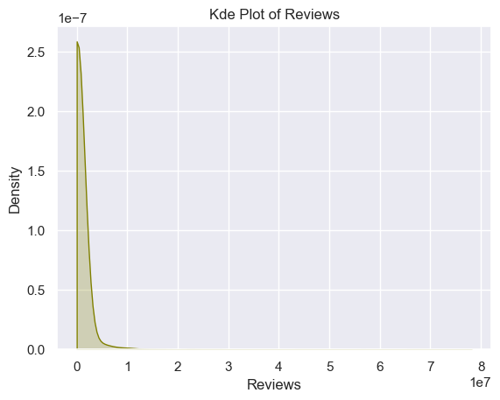
Reviews (User’s Qualitative Assessment)

Slide 13
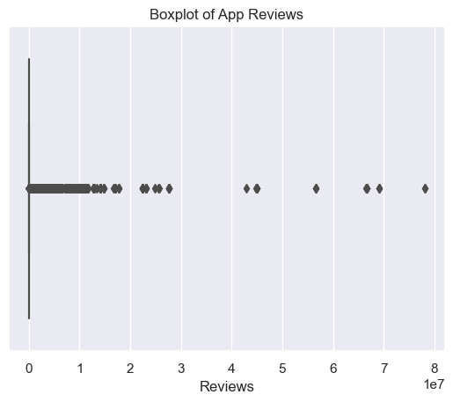
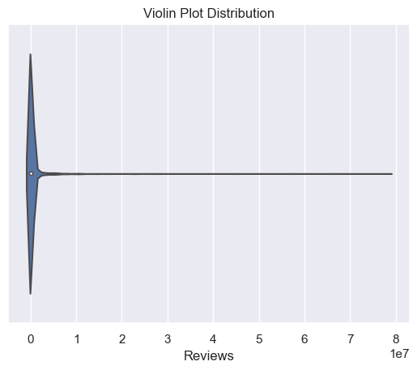
Statistical Distributions of Reviews

Slide 14
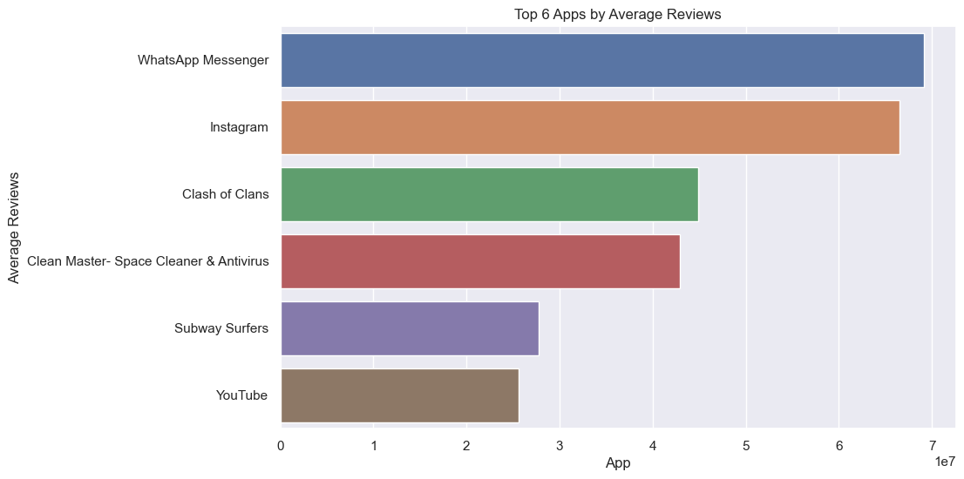
Products with High Reviews & Ratings

Slide 15
Observations
Right skewed distribution
Average number of reviews is 444,152 and median 2094.
Facebook had 78,156,306 reviews but unimpressive rating!
Others with good reviews are : WhatsApp Messenger, Instagram, Clash of Clans, Clean Master- Space Cleaner & Antivirus and Subway Surfers.
Notable : WhatsApp, Instagram, Clash of Clans: At least 444K Reviews & At least 4.5 Rating. Active engagement; Eligible for advertisement.
High number of reviews does not mean high rating!

Slide 16
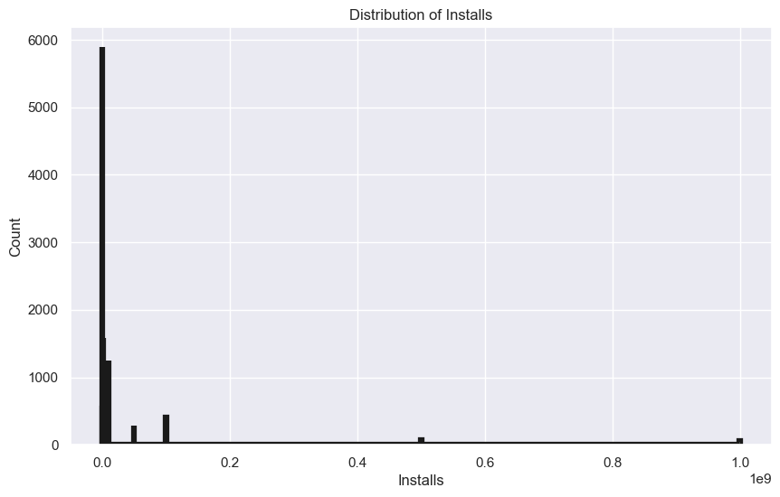
Installs (Number of product installations)

Slide 17
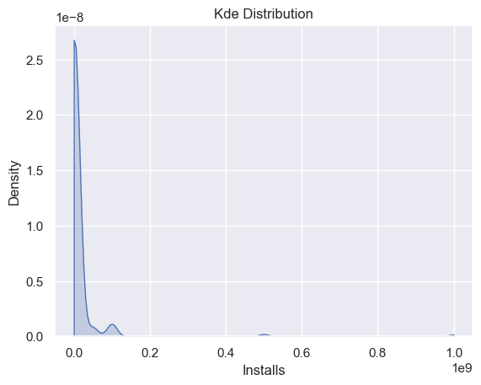
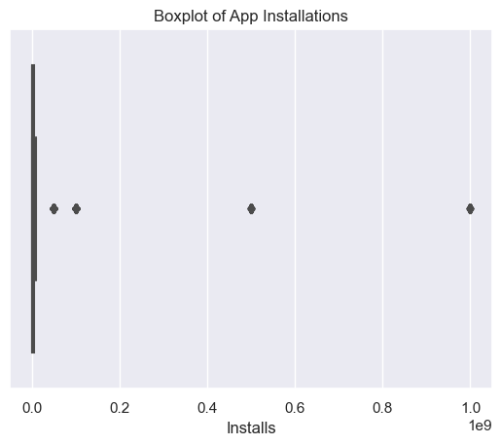
Statistical Distribution of Installs

Slide 18
Observation
Right skewed distribution.
Mean number of installations is 15,464,338 and median 100K.
58 products (0.5%) have 1B installs. Three are Subway Surfers, Facebook & Messenger.
Facebook : 1B installations & At least 78M reviews; Unexceptional Rating; Eligible for advertisement.
Notable : Subway Surfers, Instagram & Google Photos: 1B installations & At least a 4.5 rating.
Eligible for investment.

Slide 19
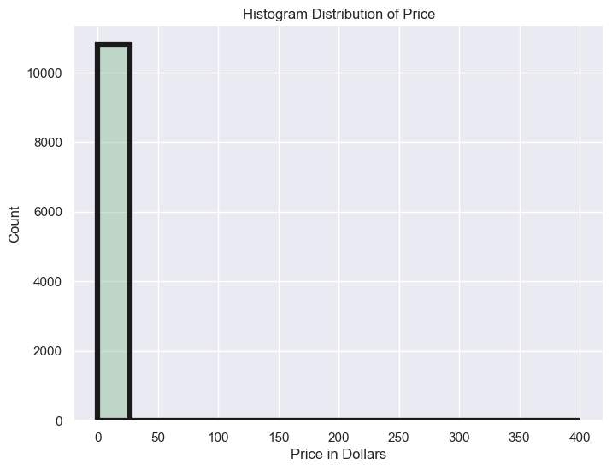
Price (Cost of product)

Slide 20
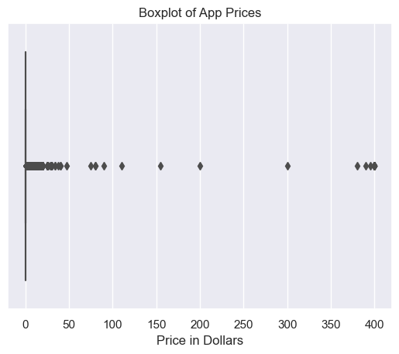
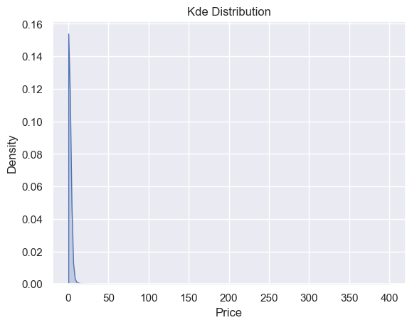
Statistical Distribution of Price

Slide 21
Observations
Right skewed distribution.
99.8% (10816) products at most $50 ; 92.6% (10040) products free.
0.22 % (24) products more than $50.
Different versions of the I'm Rich lifestyle app makes most of this share.
Most installed paywalled products : Minecraft, Hitman Sniper, Beautiful Widgets.
Minecraft showed best performance – good ratings and reviews and high installs; Could be good for investment and advertisement.

Slide 22
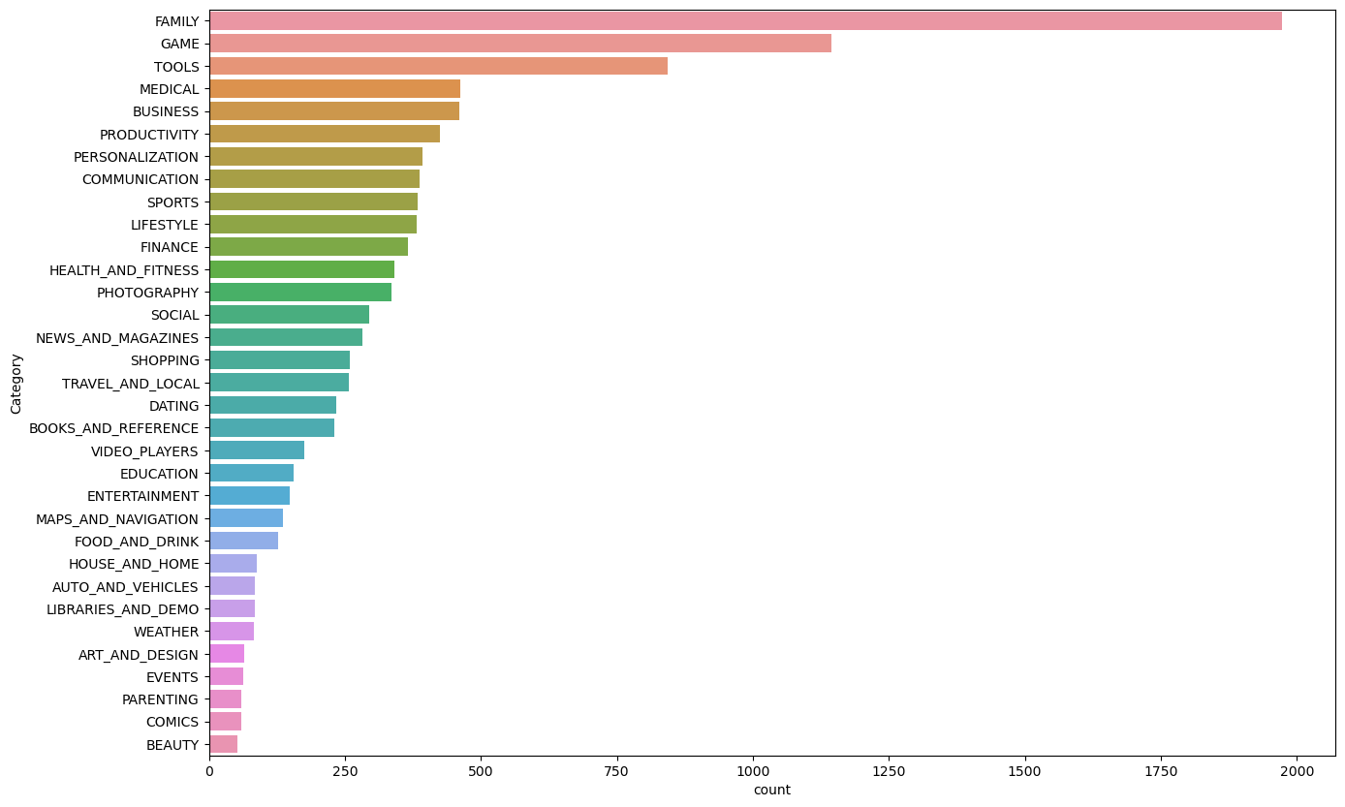
Category (Grouping based on shared purpose)

Slide 23
Observation:
18.2% (1972) of products are in the Family Category.
Products in (Arts & Design, Events, Parenting, Comics, Beauty) respectively comprise less than 3% of the play store.
Disinterest or Ripe market for developers?

Slide 24
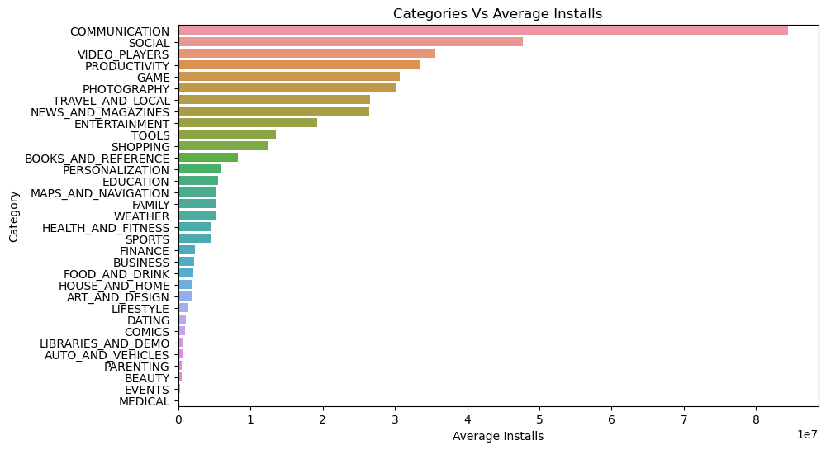
Installs per Category

Slide 25
Observation
Notable : Messenger - Text and Video Chat For Free, Skype, Google Chrome, Hangouts, WhatsApp Messenger & Gmail.
All have 1B installs!

Slide 26
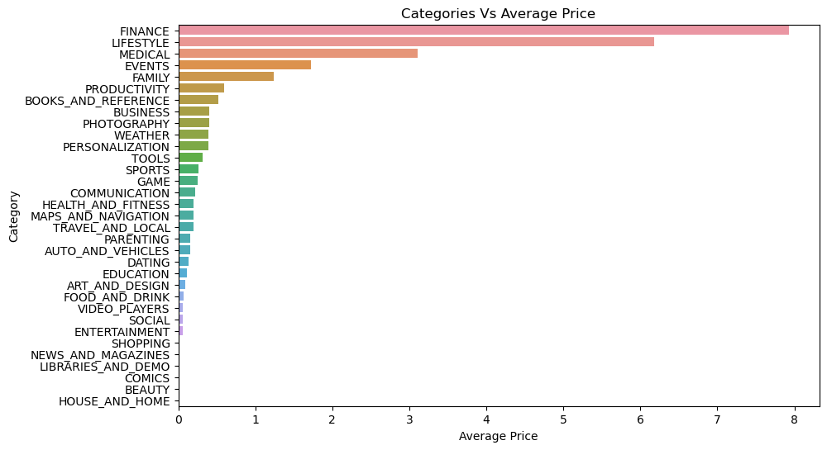
Price per Category

Slide 27
Observation:
Different versions of the I am Rich Lifestyle App.
Costs at least $390 !

Slide 28
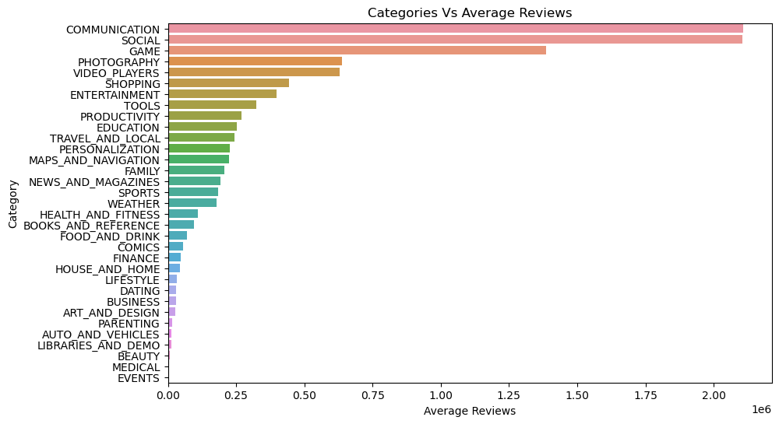
Reviews per Category

Slide 29
Observations:
COMMUNICATION
Notable : WhatsApp Messenger and Messenger - Text & Video Chat For Free
At least 69M and 56M reviews respectively.
SOCIAL
Notable : Facebook, Instagram and Snapchat .
78M, 66M & 17M reviews respectively.

Slide 30
Content Rating (Grouping based on age)
Everyone - For all age groups
Everyone 10+ - All ages above 10 years.
Teen - For teenagers
Mature 17+ - All ages above 17 years
Adult only – For all adults
Unrated – No categorization

Slide 31
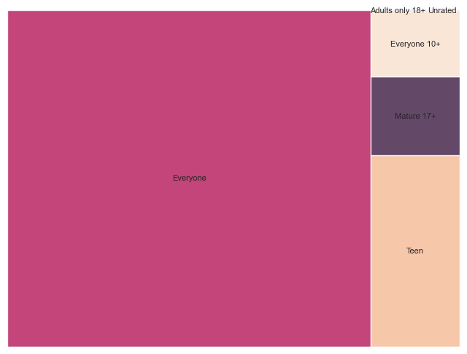
Content Rating

Slide 32
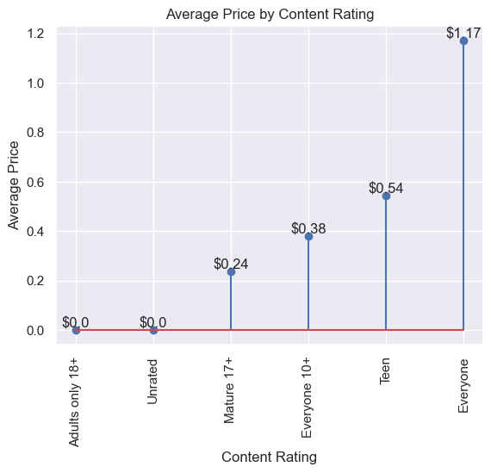
Price per Content Rating

Slide 33
Observation
‘Everyone’ highly influenced by different versions of the I am Rich app !
Least price is $390.

Slide 34
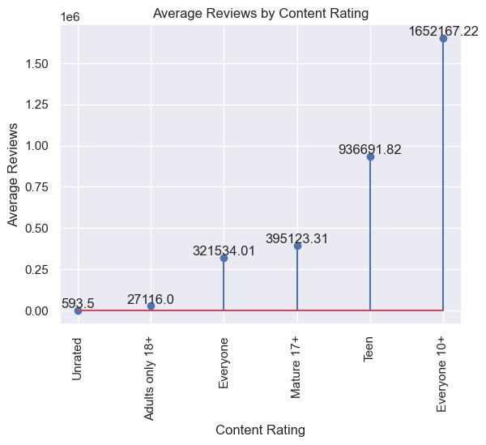
Reviews per Content Rating

Slide 35
Observation
Notable : Clash of Clans, Subway Surfers, Clash Royale and Shadow Fight 2.
At least 44M, 27M, 23M & 10M reviews respectively!
Are all free games!

Slide 36
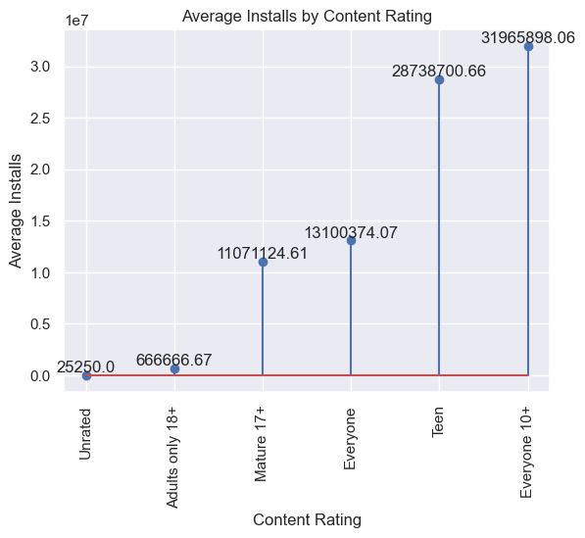
Installs per Content Rating

Slide 37
Observations
Notable : Subway Surfers, Flipboard (News & Magazine) & Roblox (Game).
1B, 500M & 100M installs respectively.
Free products with great rating!

Slide 38
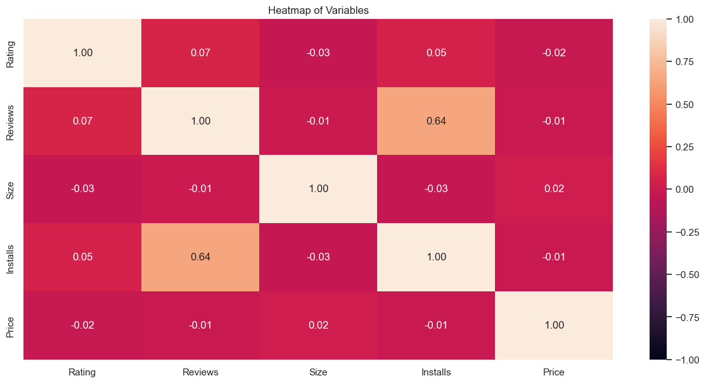
HEATMAP

Slide 39
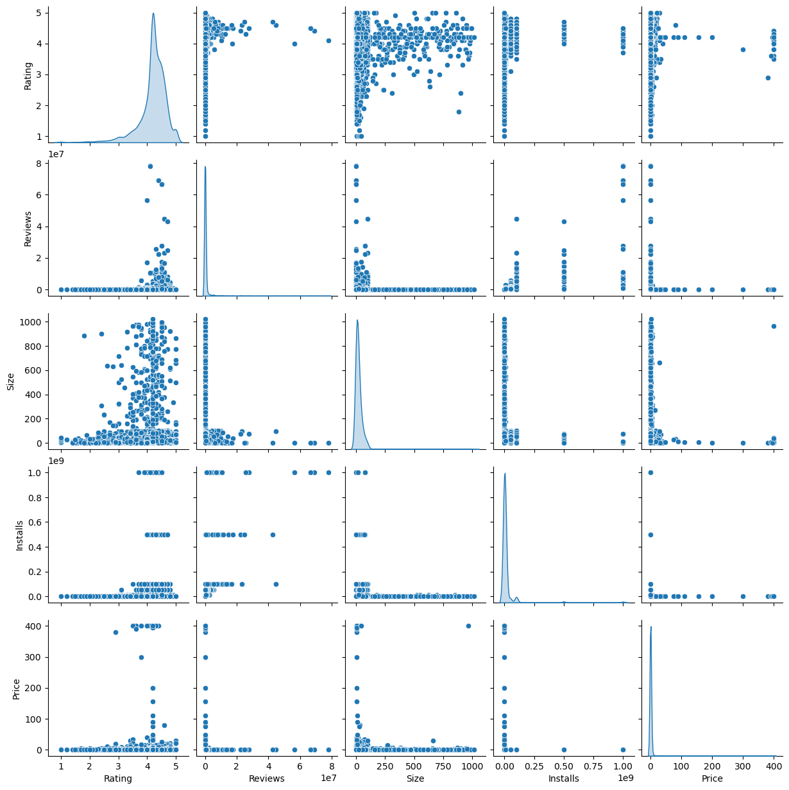
Pairwise Relationship

Slide 40
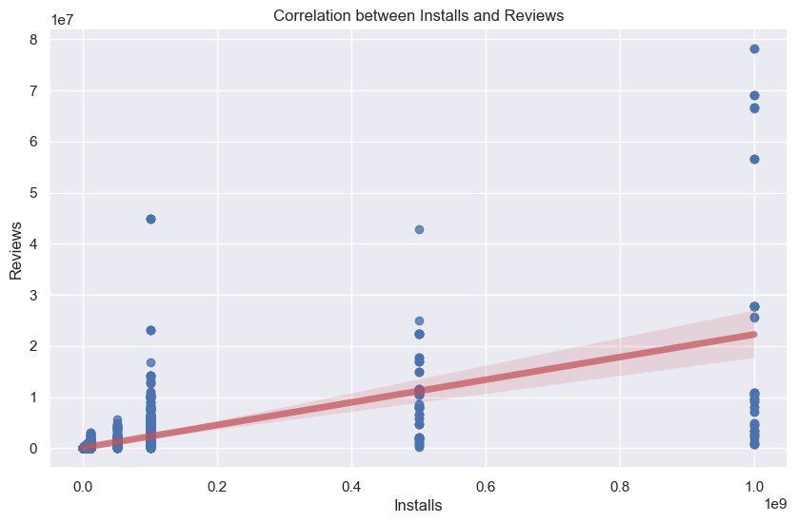
Reviews vs Installs

Slide 41
Observations
Reviews and Installs show the most significant positive correlation; Not too strong though.
A hint at random user behaviour.
NO two variables indicated a negative correlation.
An increase in installations shows a corresponding rise in number of reviews.

Slide 42
OBSERVATION SUMMARY
NOTABLE PRODUCTS | INVESTMENT | ADVERTISEMENT
Facebook |  | ✓
Instagram | ✓ | ✓
YouTube |  | ✓
Subway Surfers | ✓ | ✓
Minecraft | ✓ | ✓
Google Photos | ✓ | ✓
Clash of Clans | ✓ | ✓
WhatsApp | ✓
Adult Only + (Content Rating) | Potentially | Potentially

Slide 43
INSIGHTS
Instagram, Subway Surfers, Google Photos could be eligible for investment due to their great rating and installations.
Subway Surfers, Facebook, YouTube show very active engagement so could be suitable for advertisements.
WhatsApp, Instagram, Clash of Clans have at least 444K reviews and at least 4.5 rating so could be good for advertisement and investment.
Positive correlation between Reviews and Installs is good but not strong; Hints at the discretionary nature of reviews
Only Number of reviews not an advisable criteria for investment or advertisement decisions!
Price is not a strong choice factor for users. E.g. Minecraft

Slide 44
Very few apps in Adult only and Teen could suggest that the category is ripe for disruption.

Slide 45
FUTURE WORK
Perform a sentiment analysis to better understand the reviews posted by the subscribers.

Slide 46


